Slide 1
Network Games Programming
Mario.Soflano@gcu.ac.uk
Room M611A
Discord: MarioSoflano#3996

Slide 2
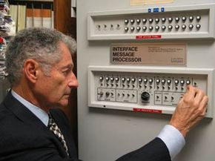
ARPANET
In 1966, the Advanced Research Projects Agency (ARPA) hosted a program with several research institutions called Resource Sharing Computer Networks. ARPA's goal was to link different computers together, both to increase overall computer power and to decentralize information storage.
Leonard Kleinrock demonstrates the functions of the Interface Message Processor (IMP), an essential component of ARPANET.
Notes:
https://computer.howstuffworks.com/arpanet.htm

Slide 3
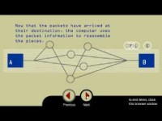
ARPANET
Notes:
A packet-switching scheme is an efficient way to handle transmissions on a connectionless network, such as the web. An alternative scheme, circuit-switched transmission, is used for voice networks. In circuit switching, lines in the network are shared among many users as with packet switching. However, each connection requires the dedication of a particular path for the duration of the connection.
-----
Before ARPANET, most computer systems consisted of a massive computer -- sometimes the size of an entire room -- with user terminals hardwired to it. A terminal was some form of user interface, often consisting of a keyboard or punch card reader. Multiple users could access the computer simultaneously, in a technique called timesharing. Other early networks required a direct connection between host computers, meaning that there was only one path for information to flow through. The direct connections limited the size of these computer networks, which became known as local area networks (LANs).
ARPA wanted to build a networked system that could stretch across the United States, linking governmental and scientific organizations in a way that had never been possible before. However, the first phase of ARPANET was much more modest: Four computer systems in different locations would link together using existing phone lines and four Interface Message Processors (IMPs).
ARPANET was to accomplish its goal using a newly invented technology called packet switching. Before the advent of packet switching, long-distance systems transmitted information through a process known as circuit switching. Systems using circuit switching sent information via a consistent circuit, created by dedicating and assembling smaller circuits into a longer path that persisted throughout the duration of the transmission. For instance, to send a large chunk of data, like a telephone call, from New York to Los Angeles, the circuit switching system would dedicate several smaller lines between intermediary cities to this chunk of information. It would connect them into a continuous circuit, and the circuit would persist until the system was done sending the information. In this case, it might reserve a line from New York to Chicago, a line from Chicago to Denver, and a line from Denver to Los Angeles. In reality these lines themselves consisted of smaller dedicated lines between closer cities. The lines would remain dedicated to this information until the transmission was complete; that is, until the telephone call was finished. After that the system could dedicate the lines to other information transmissions. This provided a very high quality of service for information transfer. However, it limited the usability of the lines in place, as the dedicated lines could only be used for one purpose at a time

Slide 4
ARPANET PROTOCOLS
What are the needs:
Create a way for users to log in to the system remotely – which then became Telnet
make it possible to move files from one machine to another – which then became File Transport Protocol (TCP)
Flexibility for computers to communicate in the network as well as expanding the network – which then Network Control Program (NCP), a symmetric host-host protocol, that controls the path and flow of data over ARPANET. It established the practice of using numeric host addresses for network communication and was a forerunner to today's domain name servers (DNS)
Notes:
One of the most important decisions the ARPANET team made was to create a standardized system of protocols that the host computers and IMPs would follow.
In 1973, Robert Kahn initiated an experiment with a technique he called internetting -- combining two or more separate networks into a larger network.
Packet switching itself is just a concept. Nodes on the network need a formal protocol collection to actually define how data should be packaged into packets and forwarded throughout the network. For the ARPANET, this protocol collection was defined in a paper known as the BBN Report 1822 and referred to as the 1822 protocol. Over many years, the ARPANET grew and grew and became part of the larger network now known as the Internet. During this time the protocols of the 1822 report evolved as well, becoming the protocols that drive the Internet of today. In 1983, ARPANET officially switched from NCP to the TCP/IP suite of protocols. Together, they form a collection of protocols now known as the TCP/IP suite.
When any file, like an email message, Hypertext Markup Language, Graphics Interchange Format or Uniform Resource Locator request is sent on the internet, it is broken down into small chunks, or bytes. The TCP layer of TCP/IP divides the file into bytes for efficient routing. Typically, a packet holds 1,000 to 1,500 bytes of information.
Each packet is separately numbered and includes the internet address of the destination. The individual packets for a given file may take different routes over the internet. Upon arrival at their destination, the packets are reassembled into the original file by the TCP layer at the receiving end.
Depending on the type of network, packets can also be referred to by names such as block, cell, frame or segment.

Slide 5
Communication Mode
Basis for Comparison | Simplex | Half Duplex | Full Duplex
Direction of Communication | Unidirectional | Two-directional, one at a time | Two-directional, simultaneously
Send / Receive | Sender can only send data | Sender can send and receive data, but one a time | Sender can send and receive data simultaneously
Performance | Worst performing mode of transmission | Better than Simplex | Best performing mode of transmission
Example | Keyboard and monitor | Walkie-talkie | Telephone
Notes:
https://teachcomputerscience.com/simplex-half-duplex-full-duplex/
There are distinct differences between full and half-duplex systems. With half-duplex mode, each transmitted character is immediately displayed on a monitor. If a device is operating in full-duplex mode, transmitted data does not appear on-screen until it is received and returned. Full-duplex Ethernet does save time when compared to half-duplex because it alleviates collisions and frame retransmissions. Sending and receiving are separate functions, creating a system where there is full data capacity in each direction. In contrast, half-duplex can be used to conserve bandwidth.

Slide 6
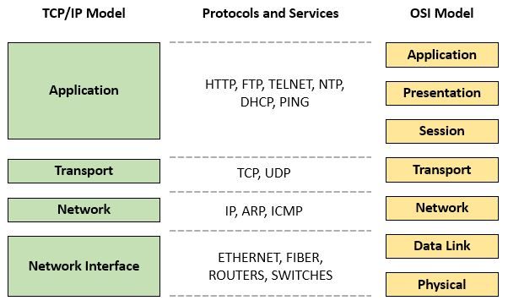
Notes:
RFC 1122, which defined early Internet host requirements, uses four layers: the link layer, the IP layer, the transport layer, and the application layer. The alternate Open Systems Interconnection (OSI) model uses seven layers: the physical layer, the data link layer, the network layer, the transport layer, the session layer, the presentation layer, and the application layer.

Slide 7
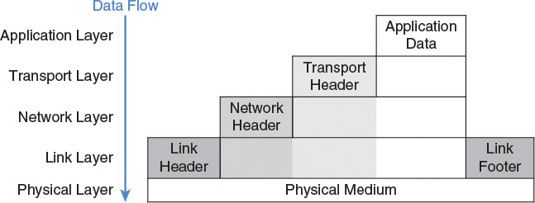
Notes:
To focus on matters relevant to game developers, a five-model layer, consisting of the physical layer, the link layer, the network layer, the transport layer, and the application layer

Slide 8
Network Protocols
Each layer has a duty, supporting the needs of the layer directly above it. Typically that duty includes
Accepting a block of data to transmit from a higher layer
Packaging the data up with a layer header and sometimes a footer
Forwarding the data to a lower layer for further transmission
Receiving transmitted data from a lower layer
Unpackaging transmitted data by removing the header
Forwarding transmitted data to a higher layer for further processing

Slide 9
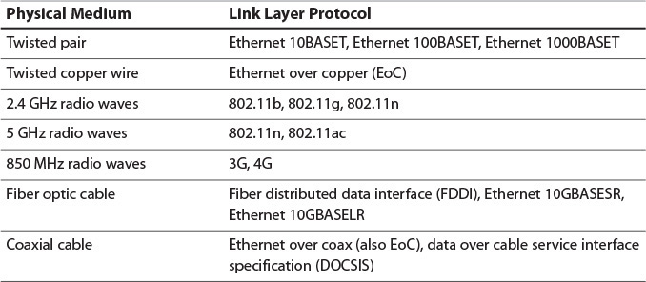
Networking Layers
Physical Layer: to provide a physical connection between networked computers, or hosts. A physical medium is necessary for the transmission of information.
Link Layer: to provide a method of communication between physically connected hosts which a source host can package up information and transmit it through the physical layer, such that the intended destination host has a sporting chance of receiving the package and extracting the desired information.
Notes:
At the very bottom of the layer cake is the most rudimentary, supporting layer: the physical layer. The physical layer’s job is to provide a physical connection between networked computers, or hosts. A physical medium is necessary for the transmission of information. Twisted pair Cat 6 cable, phone lines, coaxial cable, and fiber optic cable are all examples of physical media that can provide the connection required by the physical layer.
The link layer is where the real computer science of the layer cake begins. Its job is to provide a method of communication between physically connected hosts. This means the link layer must provide a method through which a source host can package up information and transmit it through the physical layer, such that the intended destination host has a sporting chance of receiving the package and extracting the desired information.
At the link layer, a single unit of transmission is known as a frame. Using the link layer, hosts send frames to each other. Broken down more specifically, the duties of the link layer are to
Define a way for a host to be identified such that a frame can be addressed to a specific destination.
Define the format of a frame that includes the destination address and the data to be sent.
Define the maximum size of a frame so that higher layers know how much data can be sent in a single transmission.
Define a way to physically convert a frame into an electronic signal that can be sent over the physical layer and probably received by the intended host
Ethernet is not just a single protocol. There are varieties of Ethernet which run over fiber optic cable, twisted pair cable, or straight copper cable. There are varieties that run at different speeds: As of this writing, most desktop computers support gigabit speed Ethernet but 10 GB Ethernet standards exist and are growing in popularity. To assign an identity to each host, Ethernet introduces the idea of the media access control address or MAC address. A MAC address is a theoretically unique 48-bit number assigned to each piece of hardware that can connect to an Ethernet network. Usually this hardware is referred to as a network interface controller or NIC. Originally, NICs were expansion cards, but due to the prevalence of the Internet, they have been built into most motherboards for the last few decades. When a host requires more than one connection to a network, or a connection to multiple networks, it is still common to add additional NICs as expansion cards, and such a host then has multiple MAC addresses, one for each NIC.

Slide 10
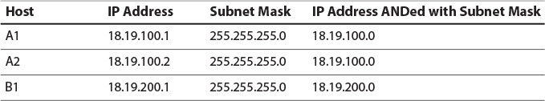
Networking Layers
Network Layer: The network layer’s duty is to provide a logical address infrastructure on top of the link layer, such that host hardware can easily be replaced, groups of hosts can be segregated into subnetworks, and hosts on distant subnetworks, using different link layer protocols and different physical media can send messages to each other.
IPv4: defining a logical addressing system to name each host individually, a subnet system for defining logical subsections of the address space as physical subnetworks, and a routing system for forwarding data between subnets. An IPv4 IP address is a 32-bit number, usually displayed to humans as four 8-bit numbers separated with periods and it allows for 4 billion unique IP addresses
A subnet mask is a 32-bit number, usually written in the four-number, dotted notation typical of IP addresses. Hosts are said to be on the same subnet if their IP addresses, when bitwise ANDed with the subnet mask, yield the same result.
Notes:
The link layer provides a clear way to send data from an addressable host to one or more similarly addressable hosts. Therefore, it may be unclear why the TCP/IP suite requires any further layers. It turns out the link layer has several shortcomings which require a superior layer to address:
Burned in MAC addresses limit hardware flexibility. Imagine you have a very popular webserver that thousands of users visit each day via Ethernet. If you were only using the link layer, queries to the server would need to be addressed via the MAC address of its Ethernet NIC. Now imagine that one day the NIC explodes in a very small ball of fire. When you install a replacement NIC, it will have a different MAC address, and thus your server will no longer receive requests from users. Clearly you need some easily configurable address system that lives on top of the MAC address.
The link layer provides no support for segmenting the Internet into smaller, local area networks. If the entire Internet were run using just the link layer, all computers would have to be connected in a single continuous network. Remember that Ethernet delivers each frame to every host on the network and allows the host to determine if it is the intended recipient. If the Internet used only Ethernet for communication, then each frame would have to travel to every single wired host on the planet. A few too many packets could bring the entire Internet to its knees. Also, there would be no ability to sanction different areas of the network into different security domains. It can be useful to easily broadcast a message to just the hosts in a local office, or just share files with the various computers in a house. With just the link layer there would be no ability to do this.
The link layer provides no inherent support for communication between hosts using different link layer protocols. The fundamental idea behind allowing multiple physical and link layer protocols is that different networks can use the best implementation for their particular job. However, link layer protocols define no way of communicating from one link layer protocol to another. Again, you find yourself requiring an address system which sits on top of the hardware address system of the link layer.
The network layer’s duty is to provide a logical address infrastructure on top of the link layer, such that host hardware can easily be replaced, groups of hosts can be segregated into subnetworks, and hosts on distant subnetworks, using different link layer protocols and different physical media can send messages to each other.
With a unique IP address for each host on the Internet, a source host can direct a packet to a destination host simply by specifying the destination host’s IP address in the header of the packet. There is an exception to IP address uniqueness. With the IP address defined, IPv4 then defines the structure of an IPv4 packet. The packet consists of a header, containing data necessary for implementing network layer functionality, and a payload, containing a higher layer’s data to be transferred.
A subnet mask is a 32-bit number, usually written in the four-number, dotted notation typical of IP addresses. Hosts are said to be on the same subnet if their IP addresses, when bitwise ANDed with the subnet mask, yield the same result. For instance, if a subnet is defined as having a mask of 255.255.255.0, then 18.19.100.1 and 18.19.100.2 are both valid IP addresses on that subnet (Table 2.3). However, 18.19.200.1 is not on the subnet because it yields a different result when bitwise ANDed with the subnet mask.

Slide 11
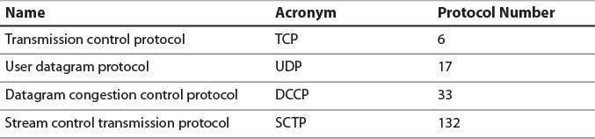
Networking Layers
Transport Layer: While the network layer’s job is to facilitate communication between distant hosts on remote networks, the transport layer’s job is to enable communication between individual processes on those hosts.
A port is a 16-bit, unsigned number representing a communication endpoint at a particular host. Ports 0 to 1023 are known as the system ports or reserved ports. Ports 49152 to 65535 are known as dynamic ports.
Notes:
Transport Layer
Because multiple processes can be running on a single host, it is not always enough to know that Host A sent an IP packet to Host B: When Host B receives the IP packet, it needs to know which process should be passed the contents for further processing. To solve this, the transport layer introduces the concept of ports. If the IP address is like a physical street address of a building, a port is a bit like a suite number inside that building. An individual process can then be thought of as a tenant who can fetch the mail from one or more suites inside that building. Using a transport layer module, a process can bind to a specific port, telling the transport layer module that it would like to be passed any communication addressed to that port.
Ports 0 to 1023 are known as the system ports or reserved ports. These ports are similar to the user ports, but their registration with IANA is more restricted and subject to more thorough review. These ports are special because most operating systems allow only root level processes to bind system ports, allowing them to be used for purposes requiring elevated levels of security.
Finally, ports 49152 to 65535 are known as dynamic ports. These are never assigned by IANA and are fair game for any process to use. If a process attempts to bind to a dynamic port and finds that it is in use, it should handle that gracefully by attempting to bind to other dynamic ports until an available one is found. As a good Internet citizen, you should use only dynamic ports while building your multiplayer games, and then register with IANA for a user port assignment if necessary.

Slide 12
Networking Layers
A socket is one endpoint of a two-way communication link between two programs running on the network. A socket is bound to a port number so that the TCP layer can identify the application that data is destined to be sent to.
Socket | Port
The word “Socket” is the combination of port and IP address. | The word “Port” is the number used by particular software.
It is used to identify both a machine and a service within the machine. | The same port number can be used in different computer running on same software.
Notes:
SocketPortThe word “Socket” is the combination of port and IP address.The word “Port” is the number used by particular software.It is used to identify both a machine and a service within the machine.The same port number can be used in different computer running on same software.
https://docs.oracle.com/javase/tutorial/networking/sockets/definition.html

Slide 13


Networking Layers
The server just waits, listening to the socket for a client to make a connection request.
On the client-side: The client knows the hostname of the machine on which the server is running and the port number on which the server is listening. To make a connection request, the client tries to rendezvous with the server on the server's machine and port. The client also needs to identify itself to the server so it binds to a local port number that it will use during this connection. This is usually assigned by the system.
If everything goes well, the server accepts the connection. Upon acceptance, the server gets a new socket bound to the same local port and also has its remote endpoint set to the address and port of the client. It needs a new socket so that it can continue to listen to the original socket for connection requests while tending to the needs of the connected client.
On the client side, if the connection is accepted, a socket is successfully created and the client can use the socket to communicate with the server.
The client and server can now communicate by writing to or reading from their sockets.
An endpoint is a combination of an IP address and a port number. Every TCP connection can be uniquely identified by its two endpoints. That way you can have multiple connections between your host and the server.
Notes:
https://docs.oracle.com/javase/tutorial/networking/sockets/definition.html

Slide 14
Networking Layers – Sockets Programming
Socket API: a collection of socket calls that enable you to perform the following primary communication functions between application programs:
Set up and establish connections to other users on the network
Send and receive data to and from other users
Close down connections
In addition to these basic functions, the API enables you to:
Interrogate the network system to get names and status of relevant resources
Perform system and control functions as required
Notes:
https://www.ibm.com/docs/en/zos/2.3.0?topic=internets-socket-api

Slide 15
Networking Layers
User datagram protocol (UDP) is a lightweight protocol for wrapping data and sending it from a port on one host to a port on another host. A UDP datagram consists of an 8-byte header followed by the payload data.
Source port (16 bits) identifies the port from which the datagram originated. This is useful if the recipient of the datagram wishes to respond.
Destination port (16 bits) is the target port of the datagram. The UDP module delivers the datagram to whichever process has bound this port.
Length (16 bits) is the length of the UDP header and payload.
Checksum (16 bits) is an optional checksum calculated based on the UDP header, payload, and certain fields of the IP header. If not calculated, this field is all zeroes. Often this field is ignored because lower layers validate the data.
Notes:
UDP is very much a no-frills protocol. Each datagram is a self-contained entity, relying on no shared state between the two hosts. It can be thought of as a postcard, dropped in the mail, and then forgotten. UDP provides no effort to limit traffic on a clogged network, deliver data in order, or guarantee that data is delivered at all. This is all very much in contrast to the next transport layer we will explore, TCP.

Slide 16
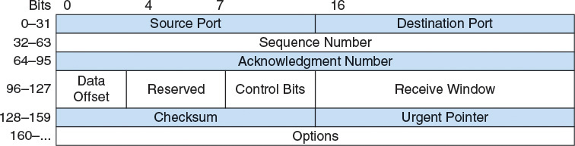
Networking Layers
Transmission control protocol (TCP) enables the creation of a persistent connection between two hosts followed by the reliable transfer of a stream of data. The structure of TCP is:
Source port (16 bits) and destination port (16 bits) are transport layer port numbers.
Sequence number (32-bits) is a monotonically increasing identifier so the sender can label data being sent and the recipient can acknowledge it.
Acknowledgment number (32-bits) contains the sequence number of the next byte of data that the sender is expecting to receive which acts as a de facto acknowledgment for all data with sequence numbers lower than this number
Data offset (4 bits) specifies the length of the header in 32-bit words for optional header elements at the end of its header, so there can be from 20 to 64 bytes between the start of the header and the data of the segment.
Control bits (9 bits) hold metadata about the header.
Receive window (16 bits) conveys the maximum amount of remaining buffer space the sender has for incoming data. This is useful for maintaining flow control, as discussed later.
Urgent pointer (16 bits) holds the delta between the first byte of data in this segment and the first byte of urgent data. This is only relevant if the URG flag is set in the control bits.
Notes:
Whereas UDP allows the transfer of discreet datagrams between hosts, transmission control protocol (TCP) enables the creation of a persistent connection between two hosts followed by the reliable transfer of a stream of data. The key word here is reliable. Unlike every protocol discussed so far, TCP does its best to ensure all data sent is received, in its intended order, at its intended recipient. To effect this, it requires a larger header than UDP, and nontrivial connection state tracking at each host participating in the connection. This enables recipients to acknowledge received data, and senders to resend any transmissions that are unacknowledged.
A TCP unit of data transmission is called a TCP segment. This refers to the fact that TCP is built for transmitting a large stream of data and each lower layer packet wraps a single segment of that stream. A segment consists of a TCP header followed by the data for that segment
Source port (16 bits) and destination port (16 bits) are transport layer port numbers.
Sequence number (32-bits) is a monotonically increasing identifier. Each byte transferred via TCP has a consecutive sequence number which serves as a unique identifier of that byte. This way, the sender can label data being sent and the recipient can acknowledge it. The sequence number of a segment is typically the sequence number of the first byte of data in that segment. There is an exception when establishing the initial connection, as explained in the “Three-Way Handshake” section.
Acknowledgment number (32-bits) contains the sequence number of the next byte of data that the sender is expecting to receive. This acts as a de facto acknowledgment for all data with sequence numbers lower than this number: Because TCP guarantees all data is delivered in order, the sequence number of the next byte that a host expects to receive is always one more than the sequence number of the previous byte that it has received. Be careful to remember that the sender of this number is not actually acknowledging receipt of the sequence number with this value, but actually of all sequence numbers lower than this value.
Data offset (4 bits) specifies the length of the header in 32-bit words. TCP allows for some optional header elements at the end of its header, so there can be from 20 to 64 bytes between the start of the header and the data of the segment.
Control bits (9 bits) hold metadata about the header. They are discussed later where relevant.
Receive window (16 bits) conveys the maximum amount of remaining buffer space the sender has for incoming data. This is useful for maintaining flow control, as discussed later.
Urgent pointer (16 bits) holds the delta between the first byte of data in this segment and the first byte of urgent data. This is only relevant if the URG flag is set in the control bits.

Slide 17
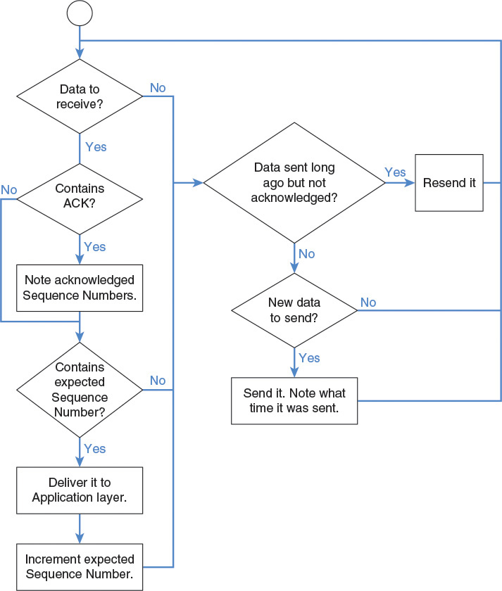
Networking Layers - TCP

Slide 18
Sockets UDP and TCP
Connection-oriented & connectionless datagram socket
A socket programming construct can make use of either the UDP or TCP protocol.
Sockets that use UDP for transport are known as datagram sockets
Sockets that use TCP are termed stream sockets.
TCP and UDP play the same role, but do it differently
Both receive transport protocol packets and pass along their contents to the Presentation Layer.
TCP divides messages into packets and reassembles them in the correct sequence at the receiving end.
It also handles requesting retransmission of missing packets.
With TCP, the upper-level layers have much less to worry about.
UDP doesn't provide assembly and retransmission requesting features.
It simply passes packets along.
The upper layers have to make sure that the message is complete and assembled in correct sequence.
Notes:
http://csis.pace.edu/~marchese/CS865/Lectures/Liu4/sockets
Datagram sockets can support both connectionless and connection-oriented communication at the application layer.
A stream socket is like a phone call -- one side places the call, the other answers, you say hello to each other (SYN/ACK in TCP), and then you exchange information. Once you are done, you say goodbye (FIN/ACK in TCP). If one side doesn't hear a goodbye, they will usually call the other back since this is an unexpected event; usually the client will reconnect to the server. There is a guarantee that data will not arrive in a different order than you sent it, and there is a reasonable guarantee that data will not be damaged.
A datagram socket is like passing a note in class. Consider the case where you are not directly next to the person you are passing the note to; the note will travel from person to person. It may not reach its destination, and it may be modified by the time it gets there. If you pass two notes to the same person, they may arrive in an order you didn't intend, since the route the notes take through the classroom may not be the same, one person might not pass a note as fast as another, etc.
So you use a stream socket when having information in order and intact is important. File transfer protocols are a good example here. You don't want to download some file with its contents randomly shuffled around and damaged!
You'd use a datagram socket when order is less important than timely delivery (think VoIP or game protocols), when you don't want the higher overhead of a stream (this is why DNS is primarily a datagram protocol, so that servers can respond to many, many requests at once very quickly), or when you don't care too much if the data ever reaches its destination.
To expand on the VoIP/game case, such protocols include their own data-ordering mechanism. But if one packet is damaged or lost, you don't want to wait on the stream protocol (usually TCP) to issue a re-send request -- you need to recover quickly. TCP can take up to some number of minutes to recover, and for realtime protocols like gaming or VoIP even three seconds may be unacceptable! Using a datagram protocol like UDP allows the software to recover from such an event extremely quickly, by simply ignoring the lost data or re-requesting it sooner than TCP would.
VoIP is a good candidate for simply ignoring the lost data -- one party would just hear a short gap, similar to what happens when talking to someone on a cell phone when they have poor reception. Gaming protocols are often a little more complex, but the actions taken will usually be to either ignore the missing data (if subsequently-received data supercedes the data that was lost), re-request the missing data, or request a complete state update to ensure that the client's state is in sync with the server’s.
https://stackoverflow.com/questions/4688855/whats-the-difference-between-streams-and-datagrams-in-network-programming

Slide 19
Socket API
Berkeley Sockets
provides a standardized way for processes to interface with various levels of the TCP/IP stack.
represents it as a file descriptor (file handle) in the Unix philosophy that provides a common interface for input and output to streams of data

Slide 20
The Berkeley socket API typically provides the following functions:
socket() creates a new socket of a certain type, identified by an integer number, and allocates system resources to it.
bind() is typically used on the server side, and associates a socket with a socket address structure, i.e. a specified local IP address and a port number.
listen() is used on the server side, and causes a bound TCP socket to enter listening state.
connect() is used on the client side, and assigns a free local port number to a socket. In case of a TCP socket, it causes an attempt to establish a new TCP connection.
accept() is used on the server side. It accepts a received incoming attempt to create a new TCP connection from the remote client, and creates a new socket associated with the socket address pair of this connection.
send(), recv(), sendto(), and recvfrom() are used for sending and receiving data. The standard functions write() and read() may also be used.
close() causes the system to release resources allocated to a socket. In case of TCP, the connection is terminated.
gethostbyname() and gethostbyaddr() are used to resolve host names and addresses. IPv4 only.
select() is used to suspend, waiting for one or more of a provided list of sockets to be ready to read, ready to write, or that have errors.
poll() is used to check on the state of a socket in a set of sockets. The set can be tested to see if any socket can be written to, read from or if an error occurred.
getsockopt() is used to retrieve the current value of a particular socket option for the specified socket.
setsockopt() is used to set a particular socket option for the specified socket.

Slide 21
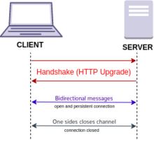
WebSocket
WebSocket
Provides persistent, bidirectional, full-duplex communications channel that operates over HTTP through a single TCP/IP socket connection between a client and server.
Based on TCP
For real-time web applications
Notes:
It's easier to communicate via TCP sockets when you're working within an intranet boundary, since you likely have control over the machines on that network and can open ports suitable for making the TCP connections.
Over the internet, you're communicating with someone else's server on the other end. They are extremely unlikely to have any old socket open for connections. Usually they will have only a few standard ones such as port 80 for HTTP or 443 for HTTPS. So, to communicate with the server you are obliged to connect using one of those ports.
Given that these are standard ports for web servers that generally speak HTTP, you're therefore obliged to conform to the HTTP protocol, otherwise the server won't talk to you. The purpose of web sockets is to allow you to initiate a connection via HTTP, but then negotiate to use the web sockets protocol (assuming the server is capable of doing so) to allow a more "TCP socket"-like communication stream.
Web browsers operate at the Application layer, whereas TCP operates at the Transport Layer. As a web application developer, it's easier to send messages over the wire via the Application Layer instead of raw bytes at the Transport Layer.
Underlying WebSockets is TCP, it's just abstracted away for simplicity.
Websocket is a application layer protocol while TCP is transport layer protocol. At transport layer, we usually have TCP and UDP protocol. Any message from application layer need to go through transport layer to be transmitted to other machine. Hence, websocket and tcp have a relationship to each other and can not be comparable.
https://newbedev.com/what-is-the-fundamental-difference-between-websockets-and-pure-tcp
Why WebSocket?
The idea of WebSockets was borne out of the limitations of HTTP-based technology. With HTTP, a client requests a resource, and the server responds with the requested data. HTTP is a strictly unidirectional protocol — any data sent from the server to the client must be first requested by the client. Long-polling has traditionally acted as a workaround for this limitation. With long-polling, a client makes an HTTP request with a long timeout period, and the server uses that long timeout to push data to the client. Long-polling works, but comes with a drawback — resources on the server are tied up throughout the length of the long-poll, even when no data is available to send.
WebSockets, on the other hand, allow for sending message-based data, similar to UDP, but with the reliability of TCP. WebSocket uses HTTP as the initial transport mechanism, but keeps the TCP connection alive after the HTTP response is received so that it can be used for sending messages between client and server. WebSockets allow us to build “real-time” applications without the use of long-polling.

Slide 22
Networking Layers
Application Layer: home to many fundamental protocols of the Internet that rely on the transport layer for end-to-end communication :
DHCP: allowing a host to request configuration information automatically when it attaches to the network
DNS: enables the translation of domain and subdomain names into IP addresses. DNS queries and responses are usually sent via UDP on port 53.

Slide 23
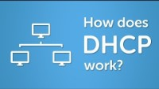
Networking Layers

Slide 24
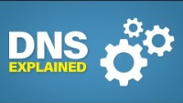
Networking Layer

Slide 25
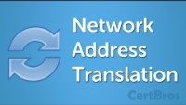
Networking Layer

Slide 26
References
https://www.techtarget.com/searchnetworking/definition/packet
https://docs-multiplayer.unity3d.com/docs/reference/glossary/high-level-terminology

Slide 27
References - Others
Papers
https://link-springer-com.gcu.idm.oclc.org/content/pdf/10.1007/s11042-015-3001-y.pdf

